Slide 1


Satellite Gravimetry
João Encarnação
teixeira@csr.utexas.edu
Center for Space Research, UT Austin

Slide 2
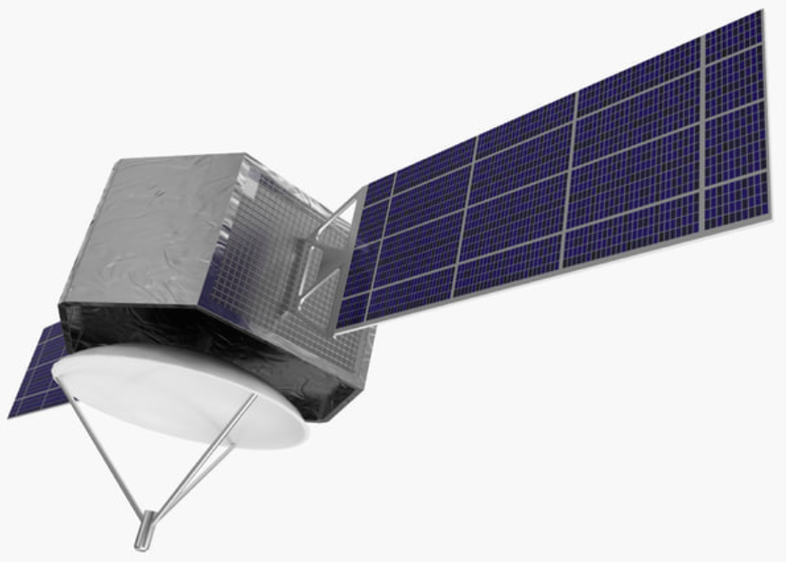
Typical Gravimetric satellite
Gravity Sensor

Slide 3
Nonsense!
Gravity Sensor

Slide 4
Summary
What
Gravity
Geoid
Mass transport processes
Why
How
Measurement principles
Satellite missions
Instrumentation
Data
Methodology
Processing strategies
Where
Globally
Regionally
When
Since early 2000s
Until foreseeable future

Slide 5
About me
2015: PhD in Space Geodesy, GRS, TU Delft Next-generation satellite gravimetry for measuring mass transport in the Earth system
2004: Master of Sciences in Aerospace Engineering, ASM, TU Delft Numerical Simulation of Launch Vehicles Supervisor
2000: Licenciatura in Aerospace Engineering, UT Lisbon Optimum Aerodynamic Shape for a High Altitude Long Endurance Aerostatic Platform (ERASMUS)

Slide 6
Gravity
Data assimilation?

Slide 7
Gravity
Data assimilation inversion!
(parameter estimation)

Slide 8
Gravity
What is measured?

Slide 9
Gravity
Newton, right?

Slide 10
Gravity
Thank you Sir Isaac Newton (or Prof. Hooke) ca. 1687

Slide 11
Gravity: planetary case
weight (N) ≠ mass (kg)

Slide 12
Gravity
Universal Gravitational Constant

Slide 13
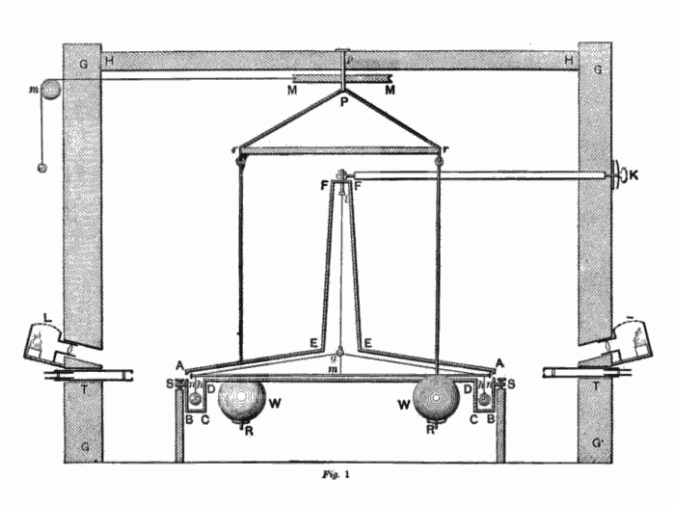
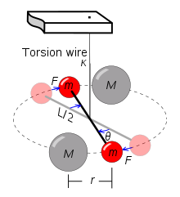
Cavendish experiment (1798)
https://en.wikipedia.org/wiki/Cavendish_experiment

Slide 14
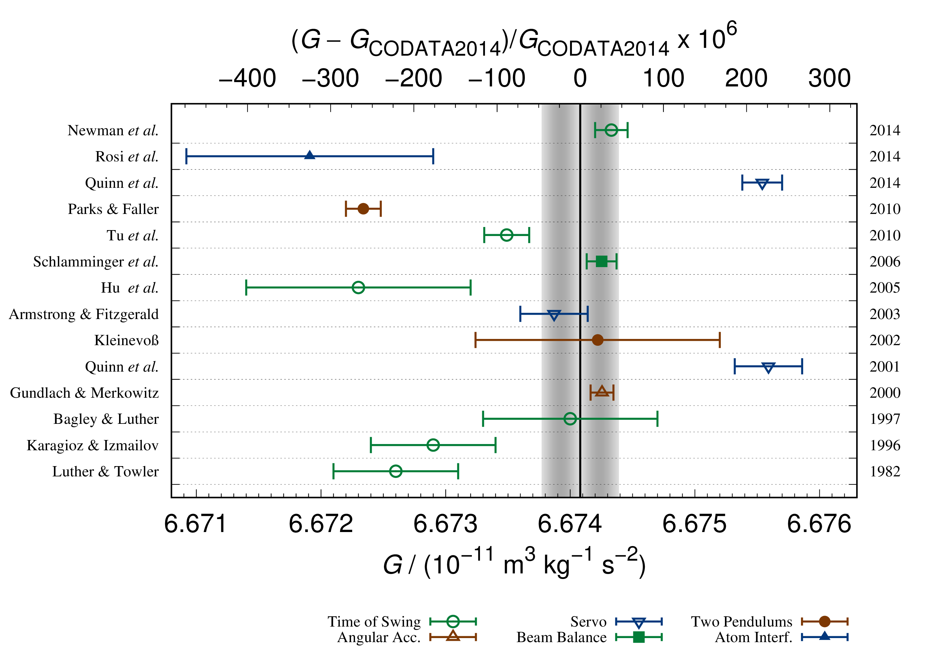
Measuring G: on-going efforts
https://www.nist.gov/image/glabel2016plotfromstephanpng

Slide 15
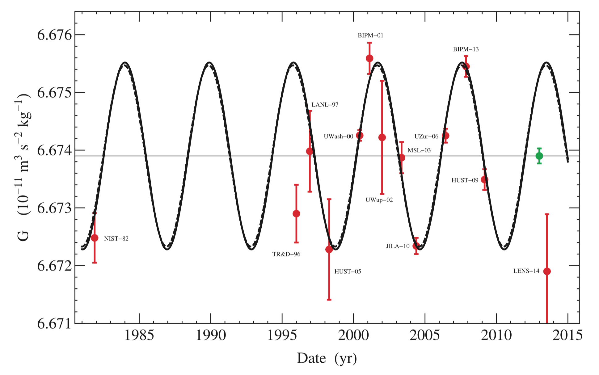
Measuring G: recent developments
Anderson et al. 2015 (http://iopscience.iop.org/article/10.1209/0295-5075/110/10002)

Slide 16
Gravity
Anyway, 9.8 m/s² right?

Slide 17
Gravity: terminology
gravitational field/force: as a result of mass (a phenomenon)
gravity field/force: caused by a planet’s mass (e.g. Earth) which, at its surface, includes the centrifugal acceleration resulting from planetary rotation (a realization of a phenomenon)

Slide 18
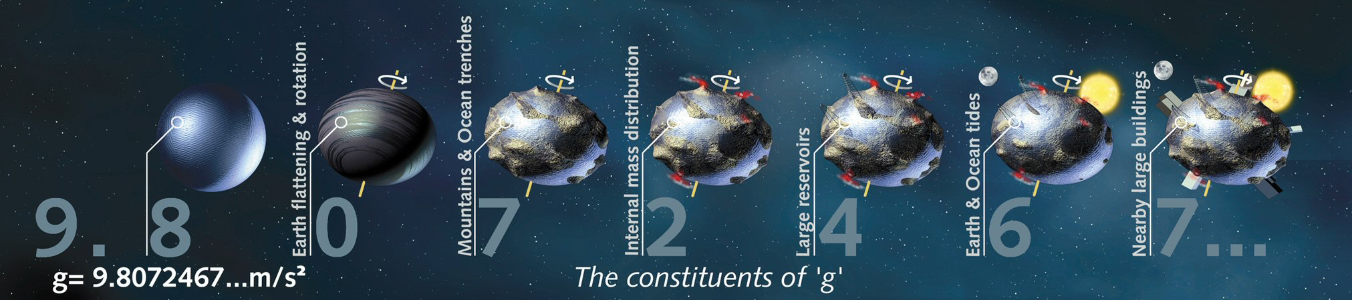
Gravity
http://www.esa.int/var/esa/storage/images/esa_multimedia/images/2008/04/constituents_of_g/9562179-4-eng-GB/Constituents_of_g.jpg

Slide 19
Gravity
How to represent these spatial changes?

Slide 20
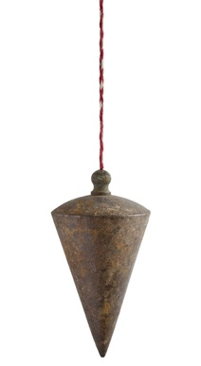
Gravity: up and down
shutterstock.com

Slide 21
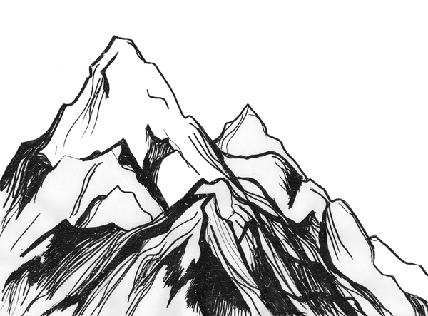
Gravity: up and down
Further reading: Schiehallion experiment (1774)
http://awesome-mountains.blogspot.com/2013/01/mountains-sketch.html
shutterstock.com

Slide 22
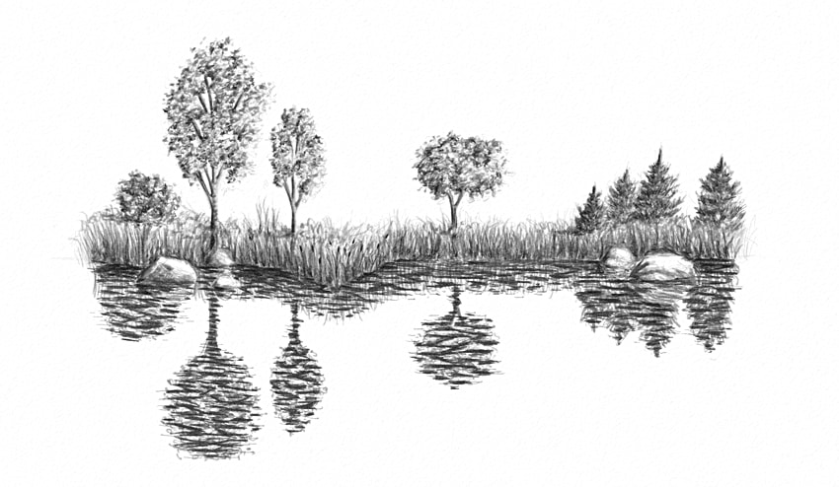
Gravity: up and down
http://awesome-mountains.blogspot.com/2013/01/mountains-sketch.html
shutterstock.com
https://design.tutsplus.com/tutorials/how-to-draw-bodies-of-water--cms-27055

Slide 23
Gravity: Physics and Geometry
Geoid
Ellipsoid
http://awesome-mountains.blogspot.com/2013/01/mountains-sketch.html
shutterstock.com
https://design.tutsplus.com/tutorials/how-to-draw-bodies-of-water--cms-27055
Notes:
- Add topography, run the marble thought experiment (blackboard)

Slide 24
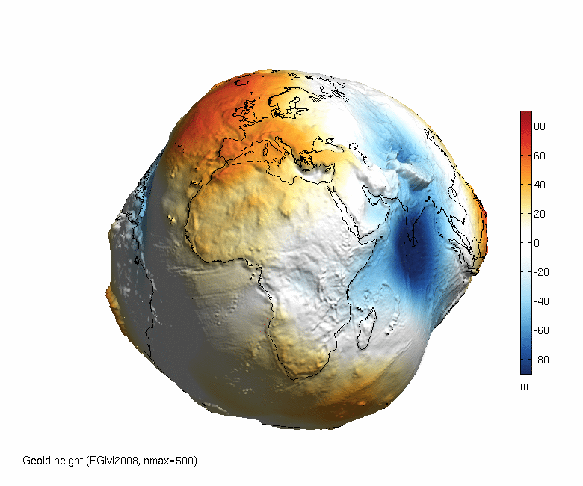
Gravity: geoid
http://www.asu.cas.cz/~bezdek/vyzkum/rotating_3d_globe/figures/rotating_3d_globe_Geoid_height_EGM2008_nmax500_px0650_angle360_fps1_BlueWhiteOrangeRed.gif
Notes:
- Mean dynamic topography

Slide 25
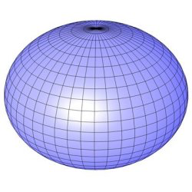

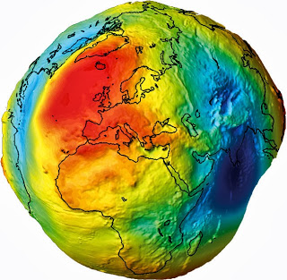
Gravity
That’s it?
-
=
+ ?
http://www.iconarchive.com/tag/earth
http://www.daviddarling.info/encyclopedia/E/ellipsoid.html
http://deepearthscience.blogspot.com/2013/10/measuring-geoid-what-is-geoid.html

Slide 26
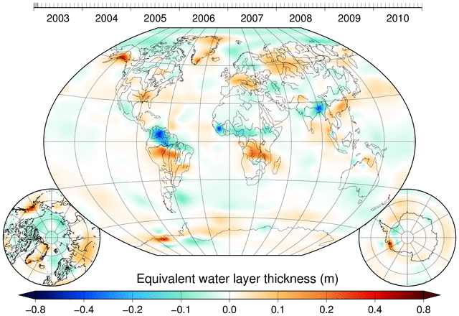
Gravity: Time-varying
http://www.citg.tudelft.nl/en/about-faculty/departments/geoscience-and-remote-sensing/research-themes/geodesy/gravity/models-data/champgracegoce-gravity-models-data/dmt-1b/
Notes:
- Global coverage: polar orbits

Slide 27
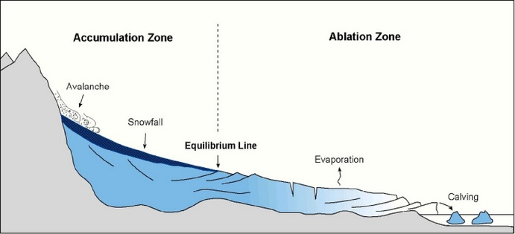
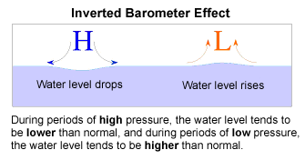
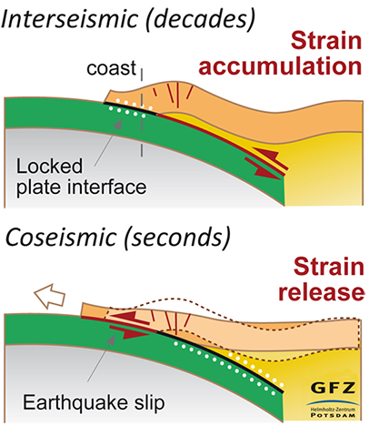
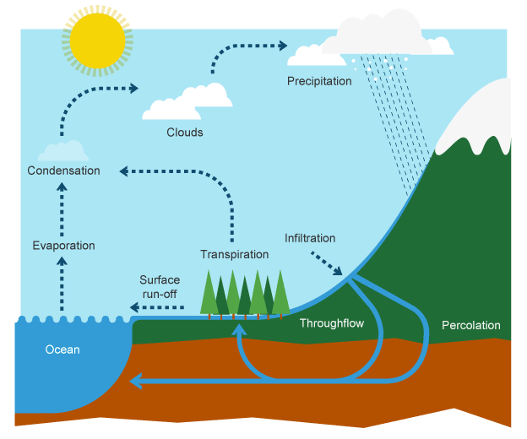
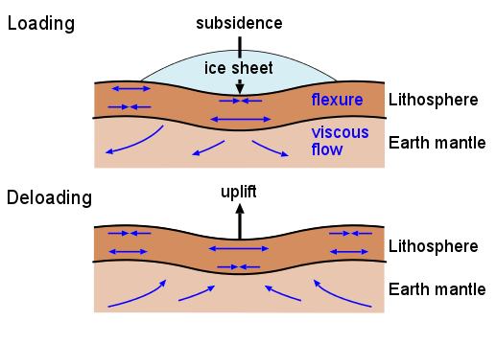
Mass transport processes
Atmosphere and Ocean
Solid Earth
Glaciology
http://www.oc.nps.edu/nom/day1/partc.html
https://uwcm-geog.wikispaces.com/EXTREME+ENVIRONMENTS
Hydrology
Glacial Isostatic adjustment
http://www.gfz-potsdam.de/en/media-communication/news/details/article/megabeben-stossen-sich-gegenseitig-an-mechanismen-fuer-erdbebenzyklen-an-chiles-plattengrenze-au/
http://www.bbc.co.uk/education/guides/z4bk7ty/revision
http://www.gfz-potsdam.de/en/section/earth-system-modelling/topics/ice-sheet-and-solid-earth-dynamics/glacial-isostatic-adjustment-gia/

Slide 28
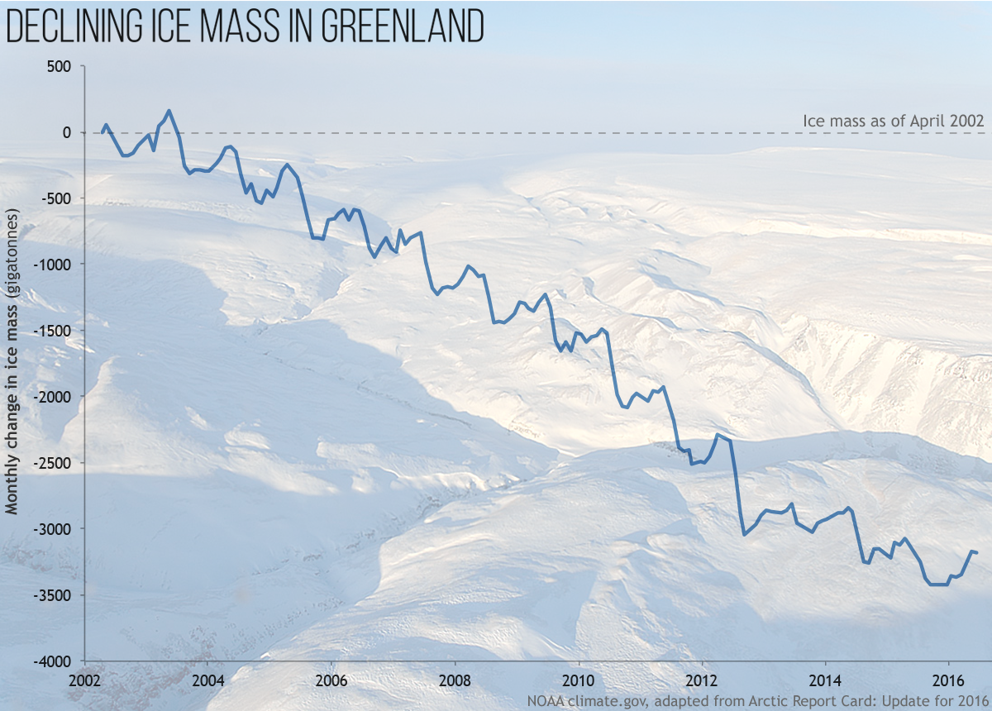
Gravity: Ice mass loss
https://www.climate.gov/news-features/featured-images/greenland-ice-mass-loss-continued-2016
Notes:
- Explain how these time series are produced

Slide 29
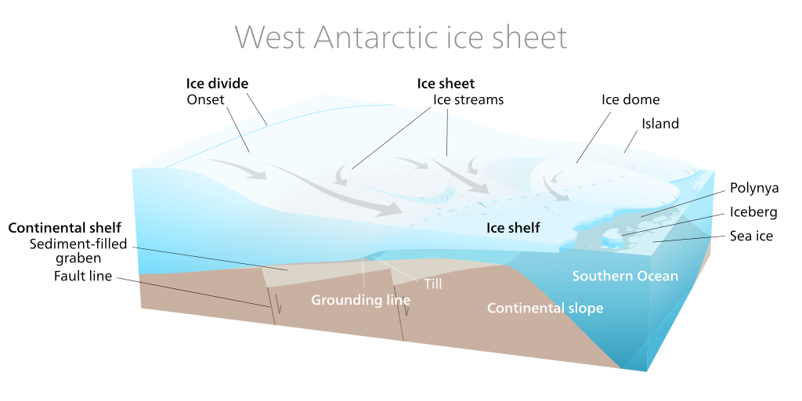
Gravity: Icebergs
Notes:
- Talk about the (non-existing) gravitational attraction of icebergs

Slide 30
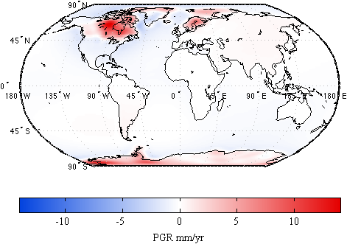
Gravity: Glacial Isostatic Adjustment (Post-Glacial Rebound)
Notes:
- Explain why studying GIA is important

Slide 31
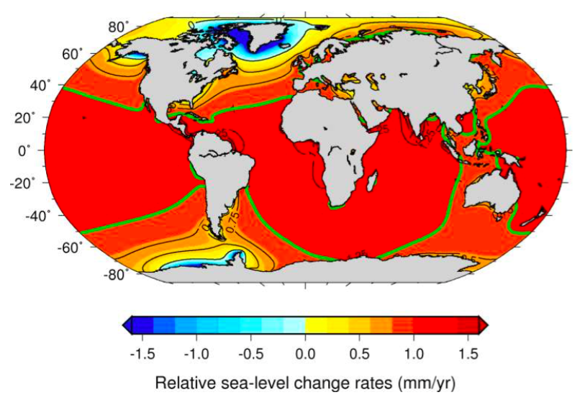
Gravity: Sea-level rise
Riva et al. 2010
Notes:
- Reinforce the idea that these are rates

Slide 32
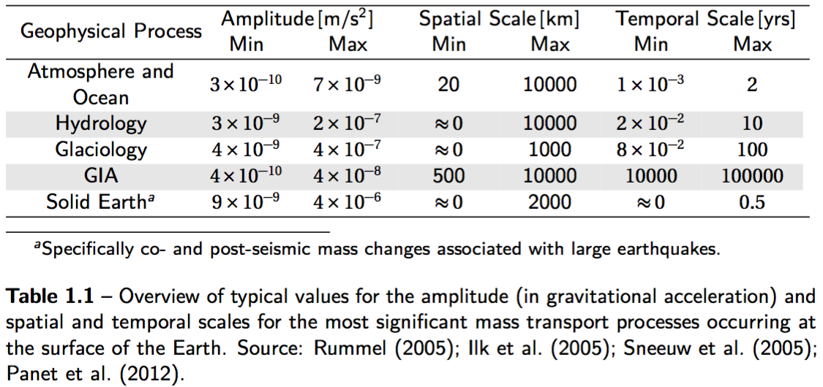
Gravity: Time-varying
https://repository.tudelft.nl/islandora/object/uuid:d0c61fd2-804b-4827-ae8a-e0e93d282a56

Slide 33
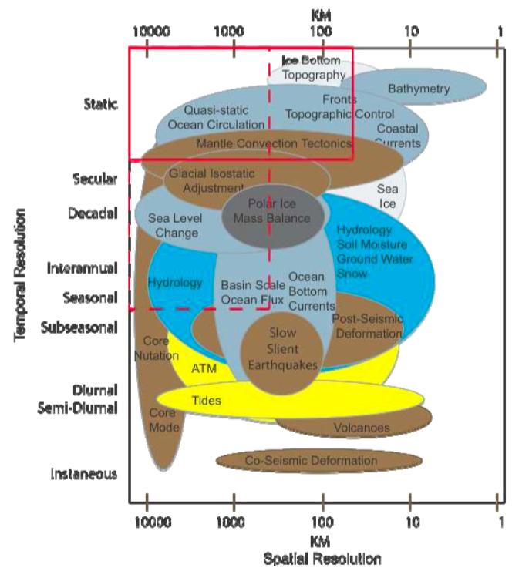
Gravity: Spatial resolution
Gruber, T. (2010). Assessment of a next Generation Gravity Mission for Monitoring the Variations of Earth’s Gravity Field. Esa, 161.

Slide 34
Gravity: motivation
Why?

Slide 35
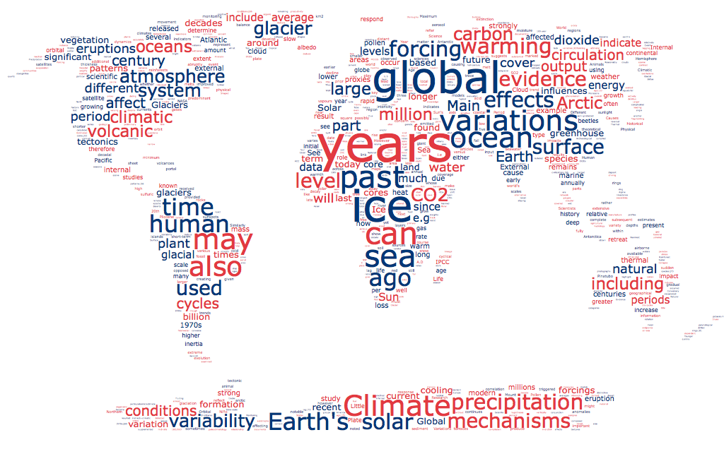
Gravity: motivation
Notes:
This is my moral high horse: connect with reservoir scientists

Slide 36
Measuring gravity
How can that be measured?

Slide 37
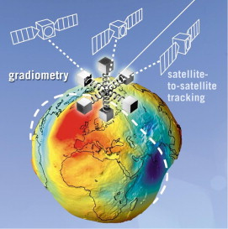
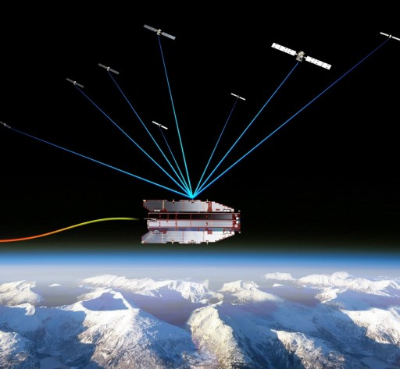
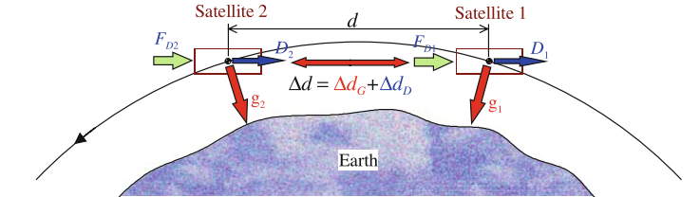
Measurement Principles
High-Low Satellite to Satellite Tracking
Low-Low Satellite to Satellite Tracking
Gradiometry
http://www.esa.int/spaceinimages/Images/2008/08/GOCE_tracked_by_GPS_satellites
http://link.springer.com/10.1007/978-3-642-03501-2_11
http://www.sciencedirect.com/science/article/pii/S0094576510002122

Slide 38
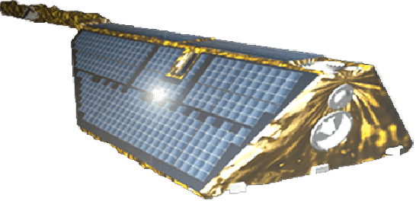
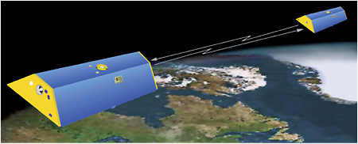
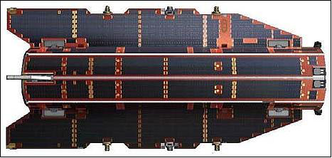
Satellite Missions
CHAMP 2000 – 2010
CHAllenging Minisatellite Payload
GRACE 2002 – present
Gravity Recovery and Climate Experiment
GOCE 2009 – 2013
Gravity field and steady-state Ocean Circulation Explorer
http://www.gfz-potsdam.de/en/section/space-geodetic-techniques/projects/champ-ro/
https://www.nap.edu/read/12954/chapter/5
https://directory.eoportal.org/web/eoportal/satellite-missions/g/goce

Slide 39
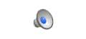
Satellite Missions: GOCE

Slide 40
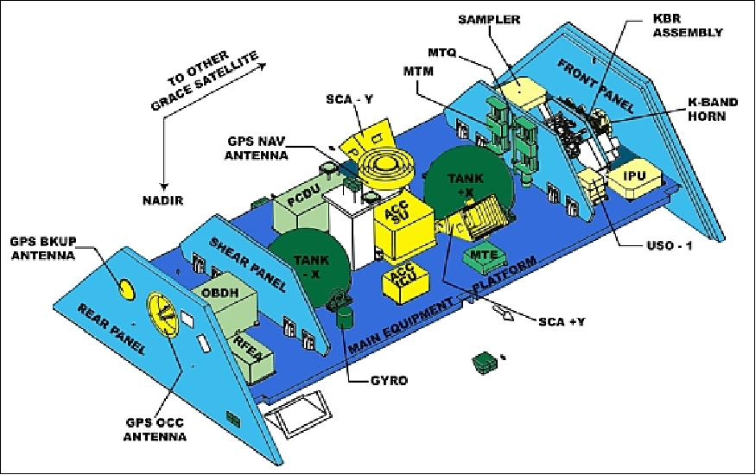
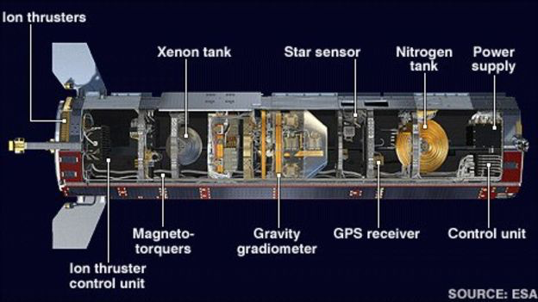
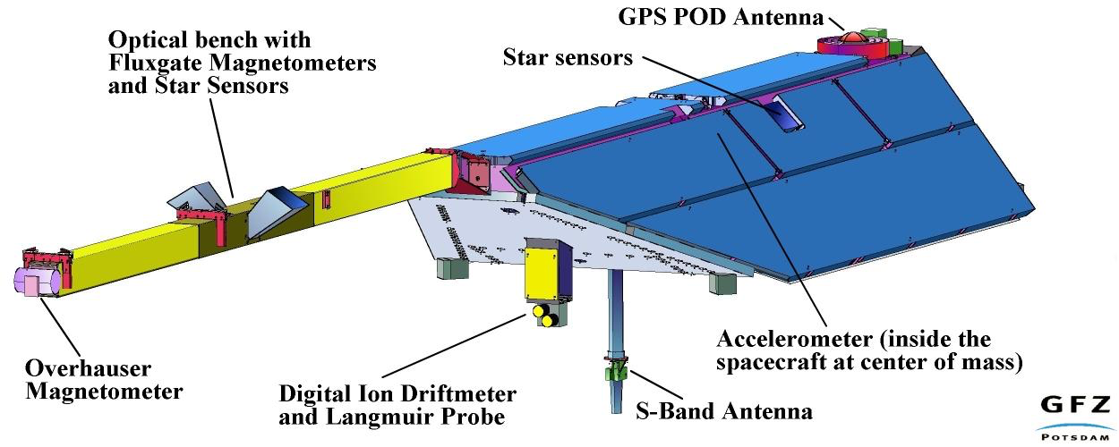
Instrumentation
Attitude
Non-gravitational accelerations
Absolute position
Relative position
CHAMP
GRACE
GOCE
http://op.gfz-potsdam.de/champ/systems/main_SYSTEMS.html
https://directory.eoportal.org/web/eoportal/satellite-missions/g/grace-fo
http://www.bbc.com/news/science-environment-24043526

Slide 41
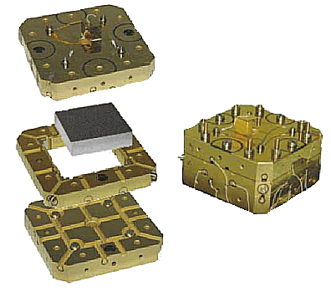
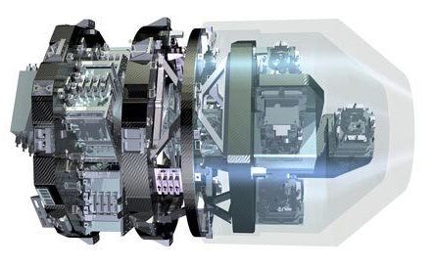
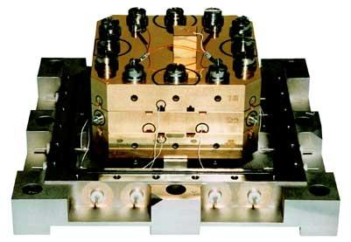
Accelerometer
CHAMP
GRACE
GOCE
https://directory.eoportal.org/web/eoportal/satellite-missions/c-missions/champ
http://op.gfz-potsdam.de/champ/systems/main_SYSTEMS.html
https://beyondthecradle.wordpress.com/2009/04/08/defying-gravity-to-define-gravity-goces-heart-starts-beating/

Slide 42
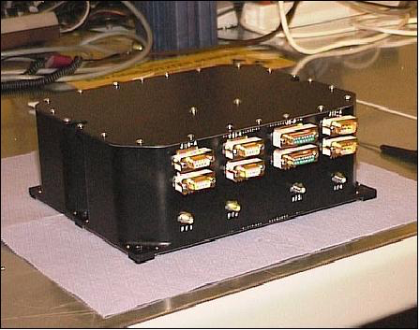
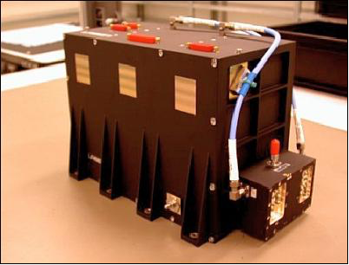
GPS Receiver
CHAMP
GRACE
GOCE
https://directory.eoportal.org/web/eoportal/satellite-missions/c-missions/champ
https://directory.eoportal.org/web/eoportal/satellite-missions/g/grace
https://directory.eoportal.org/web/eoportal/satellite-missions/g/goce

Slide 43
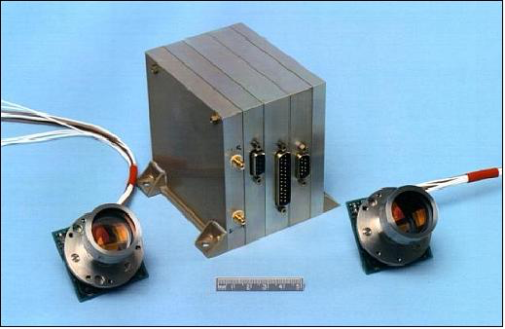
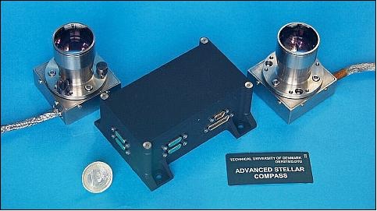
Star Tracker
CHAMP
GRACE
GOCE
https://directory.eoportal.org/web/eoportal/satellite-missions/c-missions/champ
https://directory.eoportal.org/web/eoportal/satellite-missions/g/grace
https://directory.eoportal.org/web/eoportal/satellite-missions/g/goce

Slide 44
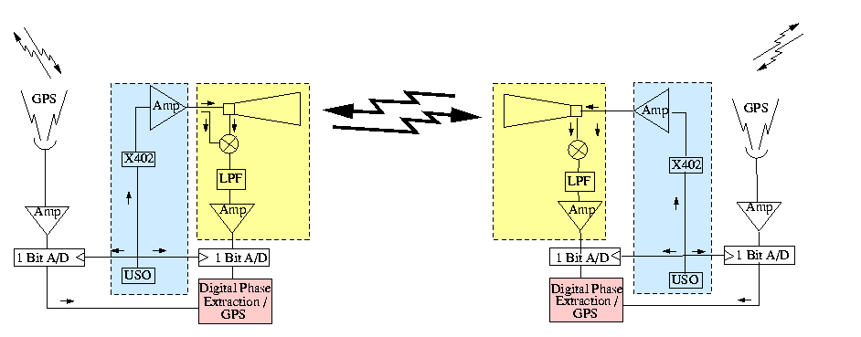
Inter-satellite ranging
CHAMP
GRACE
GOCE
N/A
N/A
K-Band Ranging (KBR) System
(24 and 32 GHz)

Slide 45
Data
What is the data like?

Slide 46
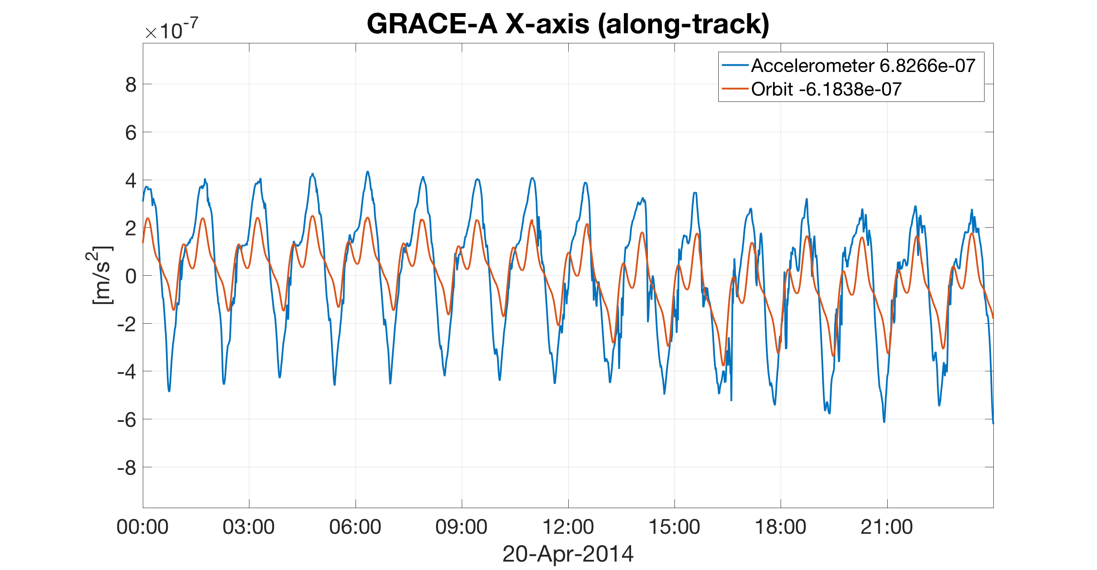
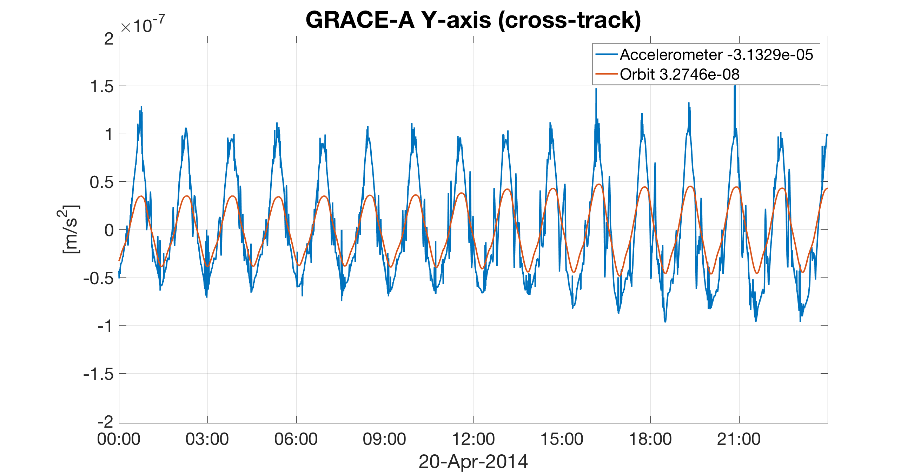
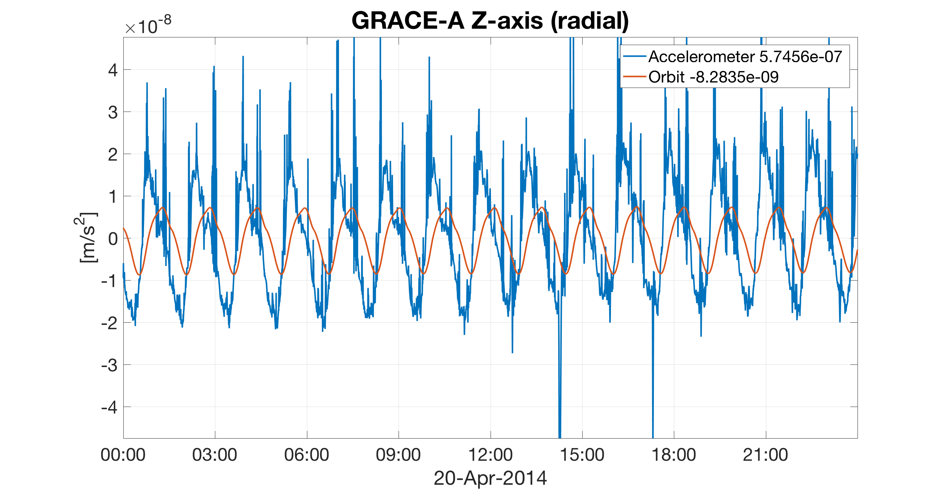
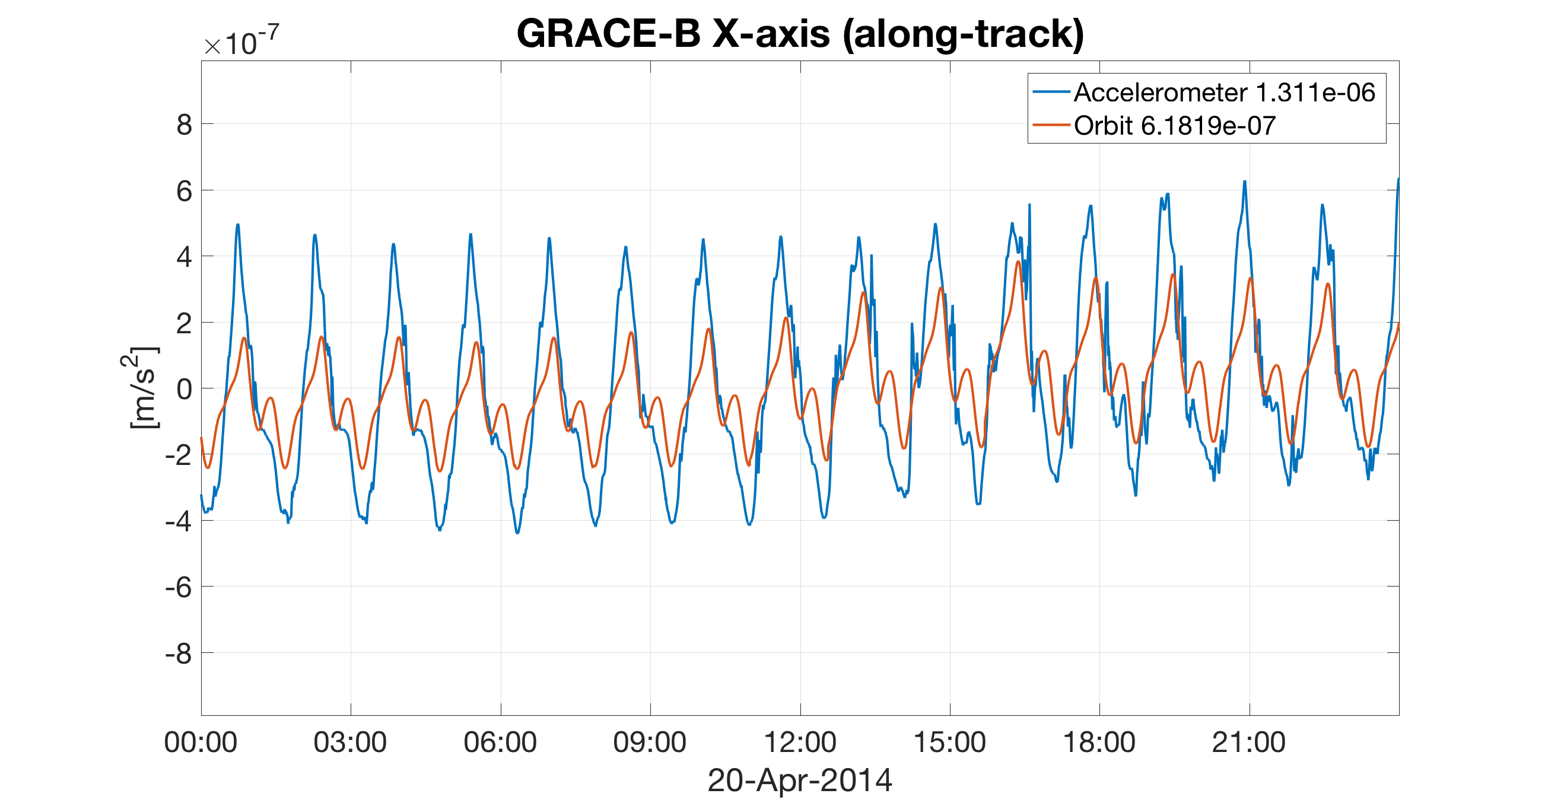
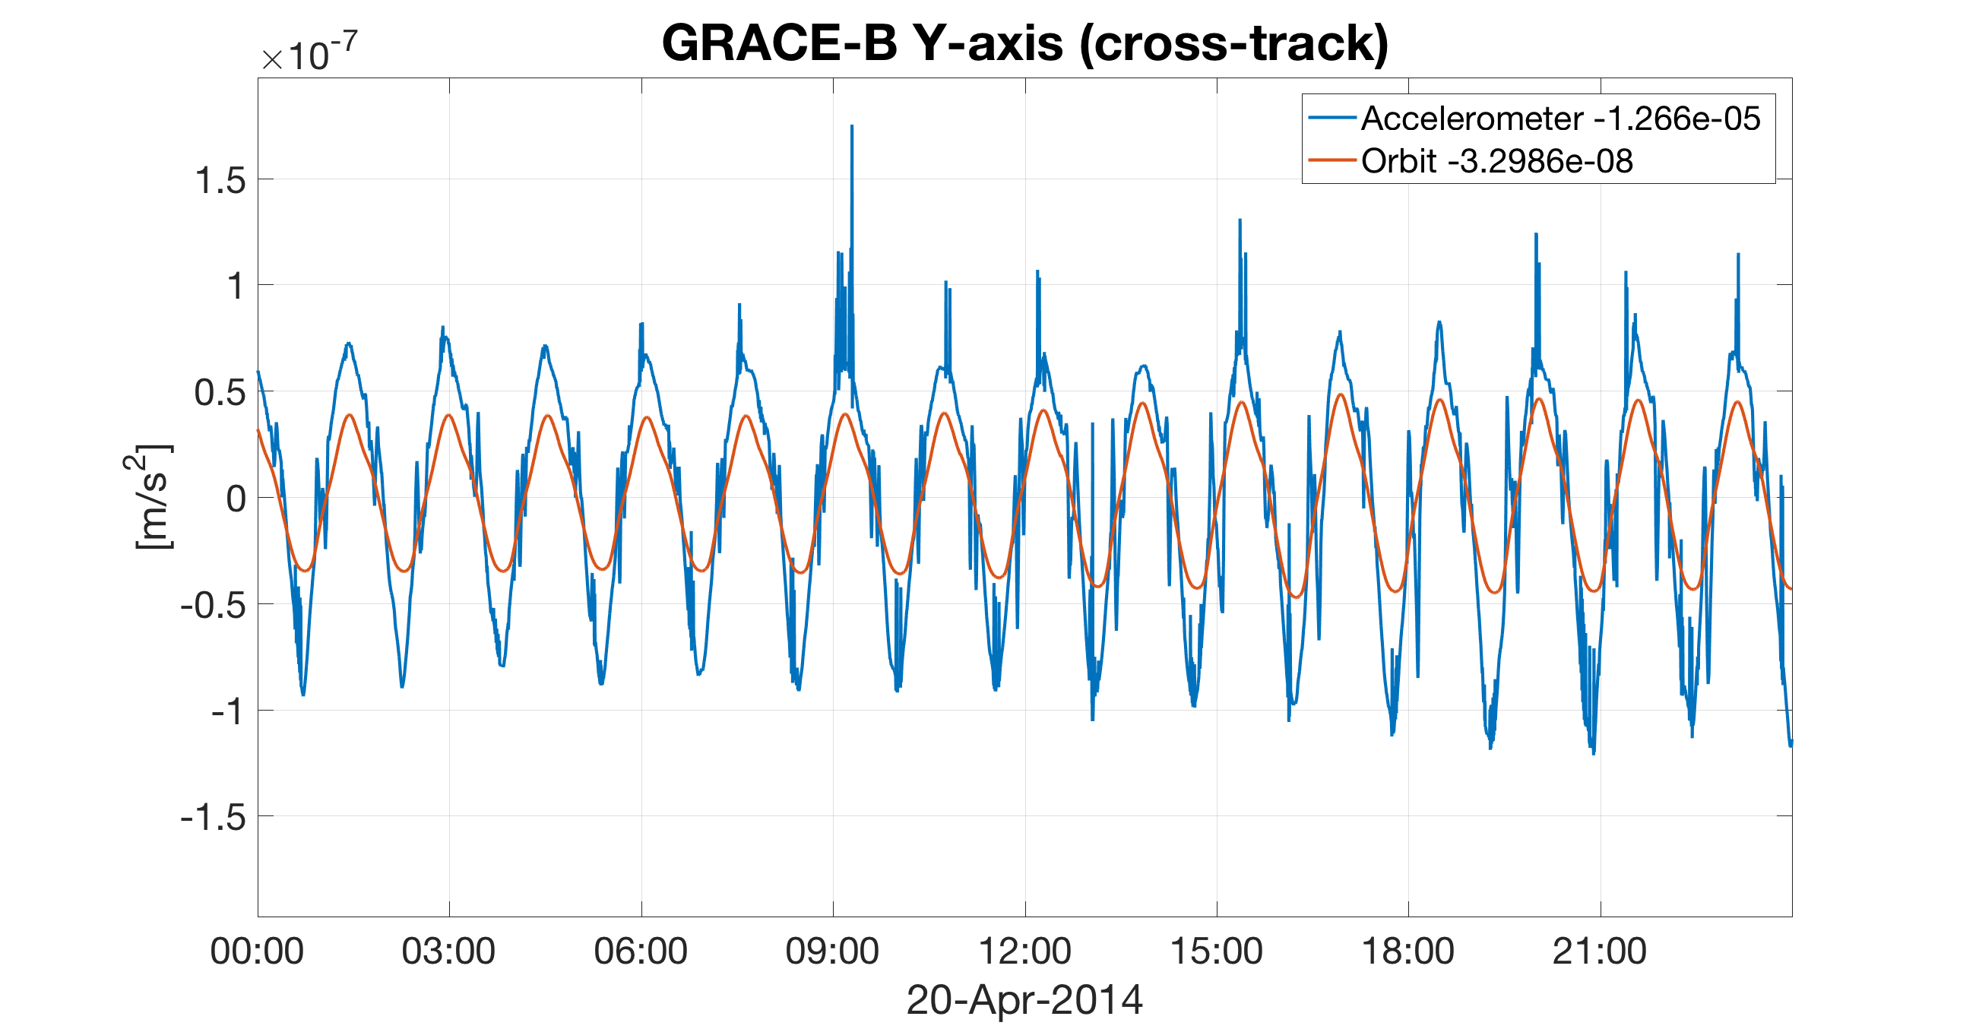
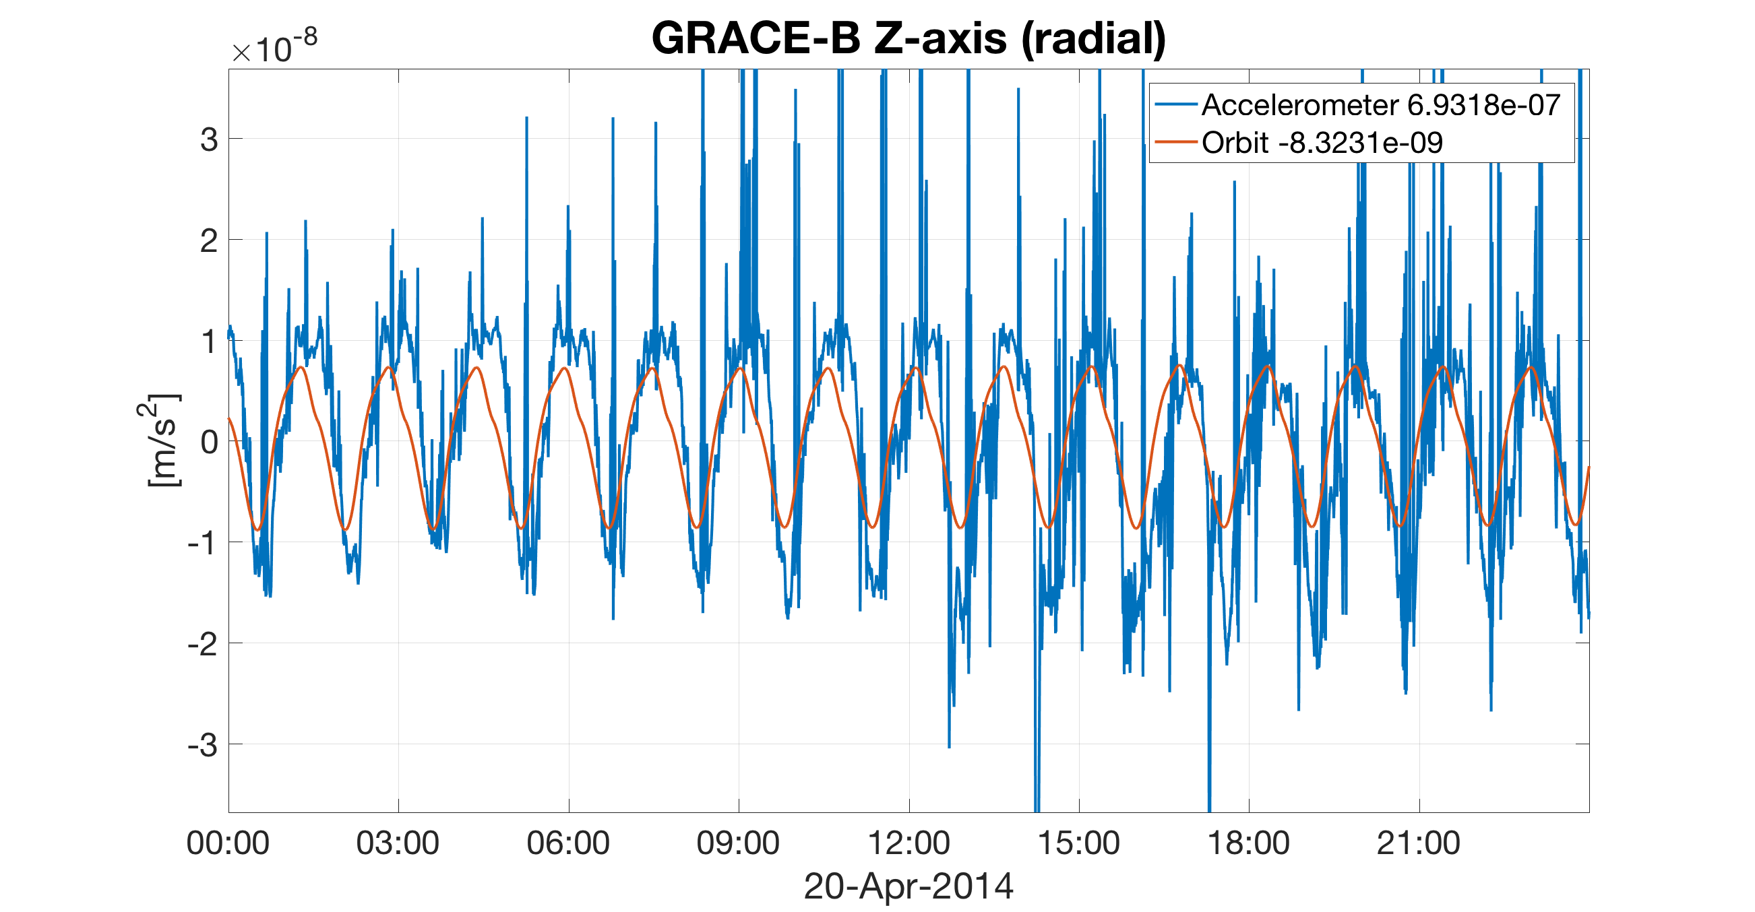
Accelerometer data

Slide 47
Accelerometer data

Slide 48
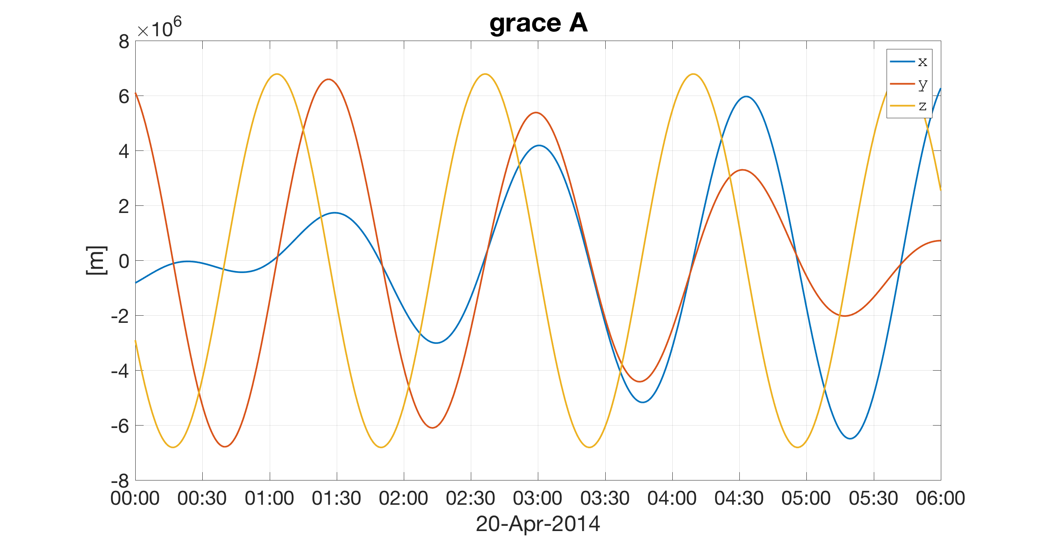



Orbit data

Slide 49




Attitude data

Slide 50
Methodology
How is the data processed?

Slide 51
Newton’s equation

Slide 52
Forces acting on the satellite

Slide 53
Gravitational accelerations

Slide 54
Non-gravitational accelerations

Slide 55
Non-gravitational accelerations
High errors!

Slide 56
Non-gravitational accelerations
The accelerometer measures all that!

Slide 57
Observation equation (epoch-wise)

Slide 58

Gravity field parameters: Spherical harmonics

Slide 59

Gravity field parameters: “mascons”

Slide 60
Processing strategies
How are the gravity field parameters estimated?

Slide 61
Processing strategies: In-situ observations
The observations are “reduced”, i.e. they are “cleaned” of:
non-gravitational information (atmospheric drag, solar radiation pressure, Earth albedo)
Trivial gravitational information (tides, astronomical bodies)
Un-observable gravitational information (atmosphere and ocean mass transport)
And:
A solution for the orbit ( ) has to be available a-priori
But:
The orbit depends on the gravity field
So:
Only kinematic orbits can be used

Slide 62
Processing strategies: Variational Equations
The orbit ( ) is co-estimated along with the gravity field parameters ( ):

Slide 63

A word on errors

Slide 64
Summary
Satellite gravimetry:
Is a large adjustment problem
Aims at describing a physical field with infinite degrees of freedom
Numerous signal sources, with different wavelengths and frequencies (tides, astronomical bodies, atmosphere and ocean, hydrology, ice-loss, GIA, megathrust earthquakes, mantle processes,…)
Unmodelled or wrongly-modelled signals act as “errors” in the data
Requires global data to solve for parameters describing a global model

Slide 65
Exercises
https://github.com/jgte/DataAssimilationSummerSchool2017

Slide 66

Orbital elements
https://en.wikipedia.org/wiki/Orbital_elements

